Slide 1
CS2040/C
Week 11b, guideline slides only

Slide 2
Plagiarism Report Updates (Week 11) ☹
PS1 (Due 05 September 2020 :O), focusing on 179 and 200 pointers
3 students (A/B/C), A “copy” B and A “copy” C caught beyond reasonable doubt
3 other students (D/E/F) have very suspicious PS1 B code fragments (especially certain parts in Radix Sort implementation)
These triples are “currently let go” but will be closely monitored in PS4-5+PE
PS2 (Due 19 September 2020 :O)
2 students (the same A/B) from above, again :O
We are suspicious with 2 other pairs (G-H and I-J) but not clear black and white (our Spider sense is triggered); accusing them will likely cause back and forth arguing so… we let them go and will monitor (and compare) their PE results
2 other students (K-L) have suspiciously similar code for both PS2 A+B
PS3 (Due 10 October 2020)
The same pair (K-L) again have very suspiciously similar code for both PS3 A+B (so a total of 4 eerily similar code), their PS2+PS3 are all 0
Then another pair (M-N) have 99% identical submissions, no variable name changed either, very black and white case, their PS3 are 0; so about 14/115 ~= 12% of this cohort are not clean already
PS4 (Due 24 October 2020)
O is caught copying a Google-searchable source almost verbatim…
Now K (above) is caught supplying another student P albeit both claiming that they did the task “independently” and referred to “the same source online”… (the tell-tale sign is there), so P gets 0 for PS4, K gets 0 for entire 15% PS for repeated offences

Slide 3
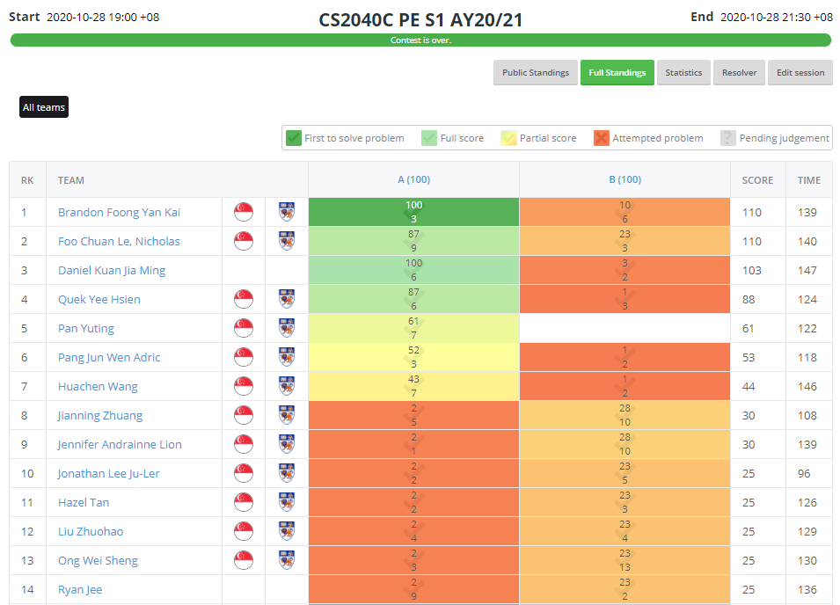
Admins – Bloody PE (grading) :O
As not many of you pass the samples (2 points in A, 3 points in B), I will have to read many source code… ☹
It will take time
The raw average without any partial grading currently stands at just 10.66/110 ☹ (not upon /200, that’s not the true limit of this test)
After very generous partial marking (probably I take up to subtask 2 marks instead of subtask 1 marks each, so A→up to 34, B→up to 38), I expect the polished average to be ~40/110 :O (36.4% :O, last AY was ~5.4%/12% = 45%)

Slide 4
Admins – Make-up/Remedial PE (draft)
I have 6 official absentees, 3 due to clashes with other NUS modules, 3 with official leave (MCs)
Harder than /universityzoning + /widgettree…, so will be even more bloody ☹, but again we prepare subtasks and you probably aware we give >0 for sample!
Schedule: Wednesday, 18 November 2020 (study week), 10am-12pm
e-proctoring, 2 proctors only, myself + Ivan (TA)
My current plan is to invite up to 2x25 – 6 = 44 students who:
Feel that they could have done better than yesterday and want to close the gap to B
Willing to sacrifice another 2 hours during study week to do this (not 2.5h)
Top 44 at https://nus.kattis.com/sessions/gvbdni, at least >= 138 points (100+38), (TAs have/will upsolve, don’t plagiarise!), and then email me to OPT-IN
PE score for this group: max(your moderated PE score, min(PE moderated average, re PE score – may or may not be moderated))

Slide 5
Review of SSSP Problem (1)
https://visualgo.net/en/sssp?slide=1 to 4-9
Q&A on SSSP part 1:
SSSP problem, review of various SSSP concepts using random graphs
Bellman-Ford algorithm, its O(kE) speedup, worst case input, quick proof of correctness and negative cycle detection bonus
Not asked:
The notations
Find real life SSSP scenarios
Notes:
Directed weighted graph, One source s, SSSP = Shortest path from that one source to ALL other vertices in graph (unreachable = +inf), result of SSSP algorithm is an SSSP spanning tree (similar with DFS/BFS spanning tree) not the focus this semester but good to know for SSSP VA OQ: ill-defined if there is a -ve cycle,
Bellman-Ford and its optimization O(kE), but k can be up to V on nasty worst case input input (reverse edge), but still good to have as it is rare, and side effect of this algorithm (can be used to help detect if the input graph actually has negative weight cycle, interested readers should attempt Kattis – shortestpath3)
Not asked:
Do this yourself
Some ideas: Going home (from source = SoC), Going to school (from source = home)

Slide 6
(Not-)Live Demo (1)
https://nus.kattis.com/problems/shortestpath1
Let me show a raw O(nm) Bellman Ford’s on this :O…
It should TLE
https://nus.kattis.com/submissions/4053497 (Steven’s view, see zipped code)
Let me show the optimization to O(km) version that terminates early if there is no more relaxation
It “pass” with “high” runtime, but technically we can make this still TLE (this problem does not have “Bellman Ford’s killer test case”)
https://nus.kattis.com/submissions/4053520 (Steven’s view, see zipped code)
We will make it better with proper Dijkstra’s algorithm soon ☺

Slide 7
Review of SSSP Problem (2)
https://visualgo.net/en/sssp?slide=5 to 6-3
Q&A on SSSP part 2:
BFS for unweighted graph, the minor changes, WA on general graph
That SSSP on 2D grid with only N/E/S/W moves can be easily computed with Manhattan distance and BFS is totally unnecessary…
Read https://stackoverflow.com/questions/15179481/how-to-calculate-distance-between-2-points-in-a-2d-matrix
Hindsight is always 20/20… we didn’t expect ¾ of the class do BFS for /universityzoning
In hindsight, we should have added smaller test case where doing BFS will not cause RTE for most of you
And probably we shouldn’t permute the faculty cells and student IDs for lower subtasks…
Anyways…
Notes:
Unweighted can also mean constant-weighted, the minor changes are trivial, basically count layer number instead of just visited-unvisited flag, WA on general graph (sssp can take more edges but smaller total edge weight)
Self rant about /universityzoning (that was supposed to be the easier task, expecting average to be around subtask 3 score, ~61) instead of what we got last night (before moderation)

Slide 8

Next e-Lecture for our Flipped Classroom
By Wed, 04 Nov 2020, please re-read https://visualgo.net/en/sssp?slide=7 until end
We will start studying Dijkstra’s algorithm
You will need it for PS5 anyway (both tasks)

